Slide 1
5
APPLICATIONS OF INTEGRATION
Copyright © Cengage Learning. All rights reserved.

Slide 2
5.3
Volumes by Cylindrical Shells
Copyright © Cengage Learning. All rights reserved.

Slide 3
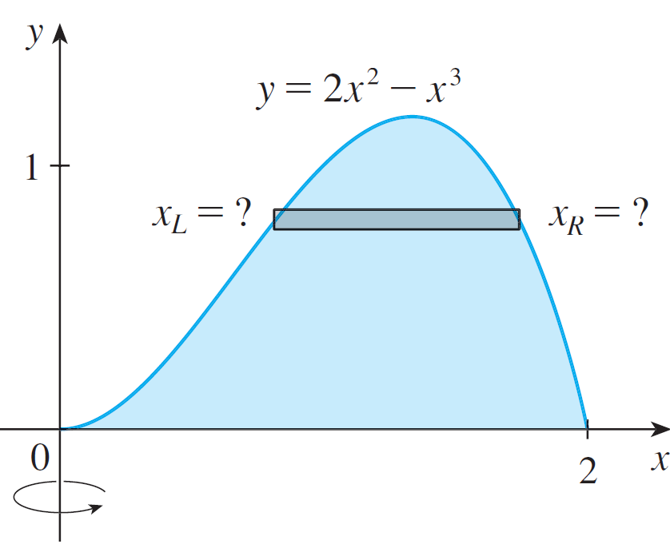
Volumes by Cylindrical Shells
Some volume problems are very difficult to handle by the methods of the preceding section.
For instance, let’s consider the
problem of finding the volume
of the solid obtained by rotating
about the y-axis the region
bounded by y = 2x² – x³ and
y = 0.(See Figure 1.)
Figure 1

Slide 4
Volumes by Cylindrical Shells
If we slice perpendicular to the y-axis, we get a washer.
But to compute the inner radius and the outer radius of the washer, we would have to solve the cubic equation
y = 2x² – x³ for x in terms of y; that’s not easy.
Fortunately, there is a method, called the method of cylindrical shells, that is easier to use in such a case.

Slide 5
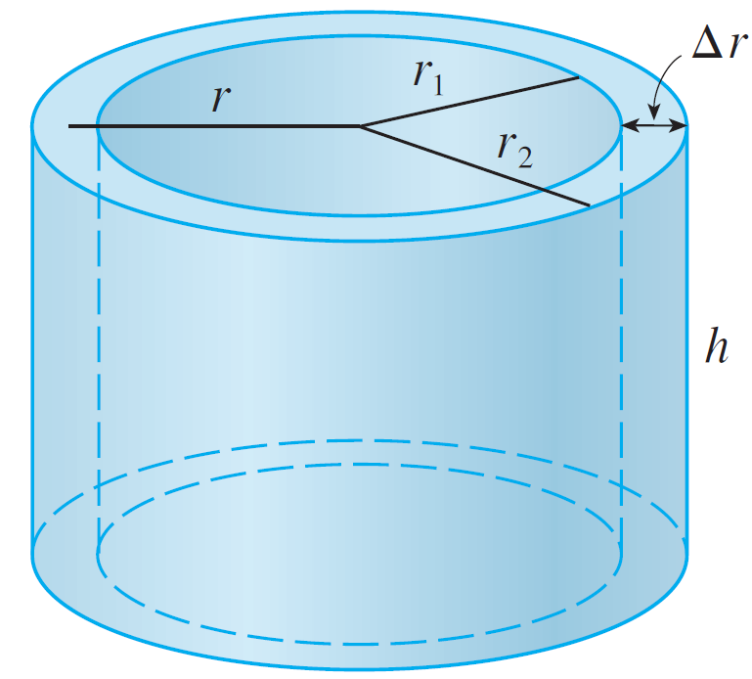
Volumes by Cylindrical Shells
Figure 2 shows a cylindrical shell with inner radius r₁, outer
radius r₂, and height h.
Figure 2

Slide 6
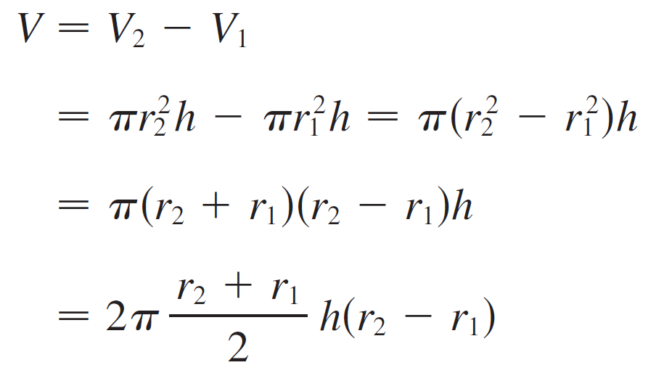
Volumes by Cylindrical Shells
Its volume V is calculated by subtracting the volume V₁ of the inner cylinder from the volume V₂ of the outer cylinder:

Slide 7

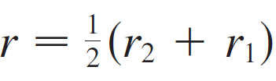
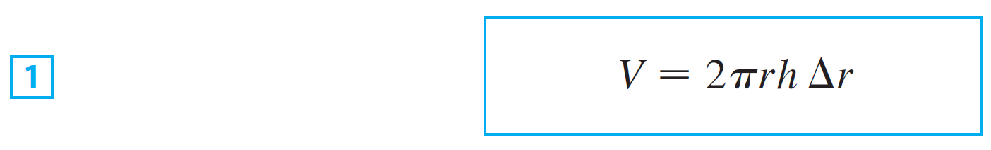
Volumes by Cylindrical Shells
If we let (the thickness of the shell) and
(the average radius of the shell), then this formula for the volume of a cylindrical shell becomes
and it can be remembered as
V = [circumference] [height] [thickness]

Slide 8
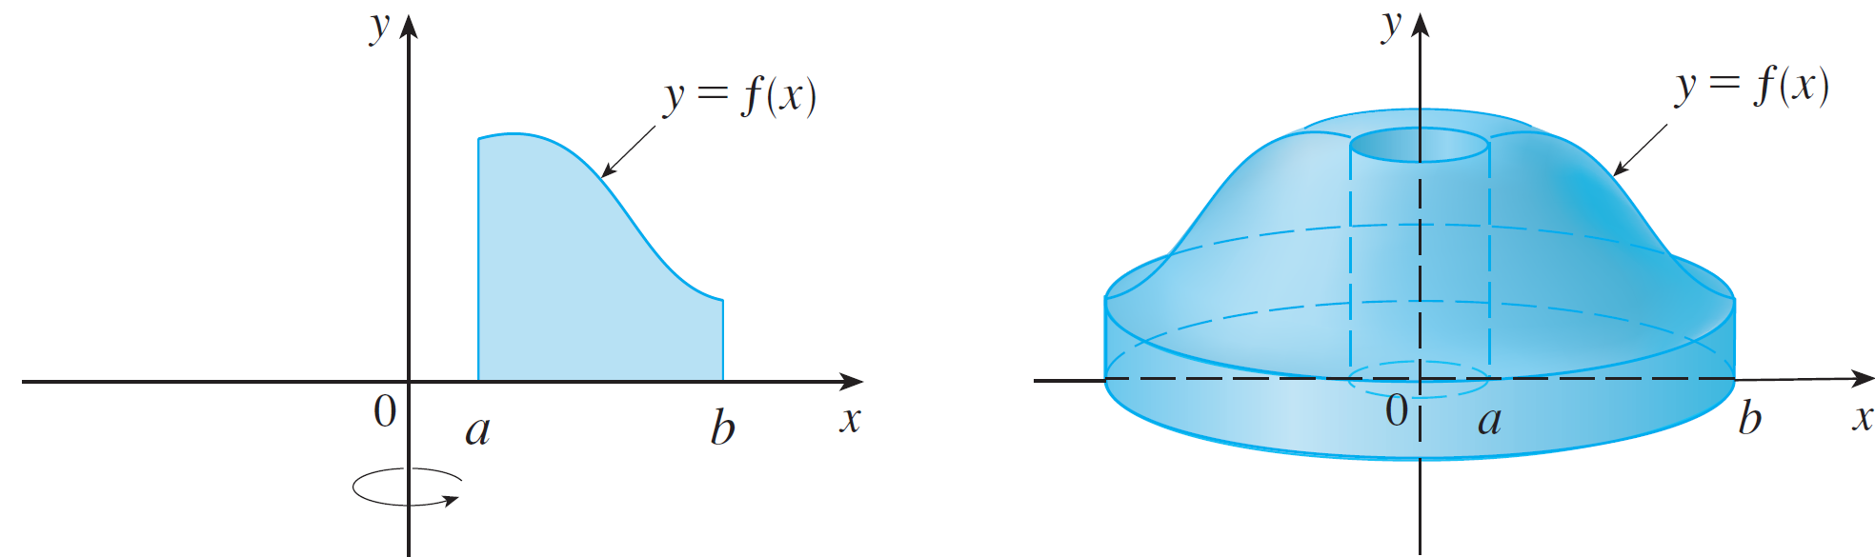


Volumes by Cylindrical Shells
Now let S be the solid obtained by rotating about the y-axis the region bounded by y = f(x) [where f is continuous and f(x) ≥ 0], y = 0, x = a, and x = b, where b > a ≥ 0. (See Figure 3)
We divide the interval [a, b] into n subintervals [x_{i – 1}, x_{i} ] of equal width and let be the midpoint of the i th subinterval.
Figure 3

Slide 9




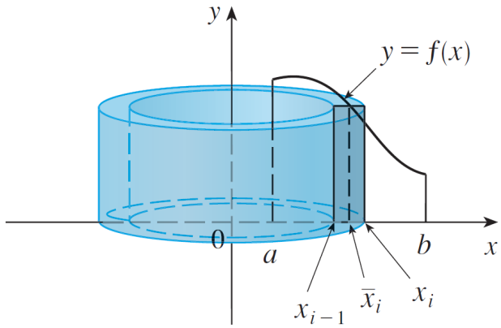
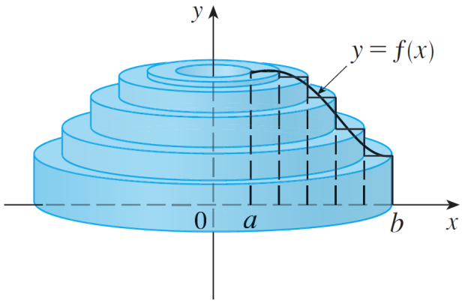
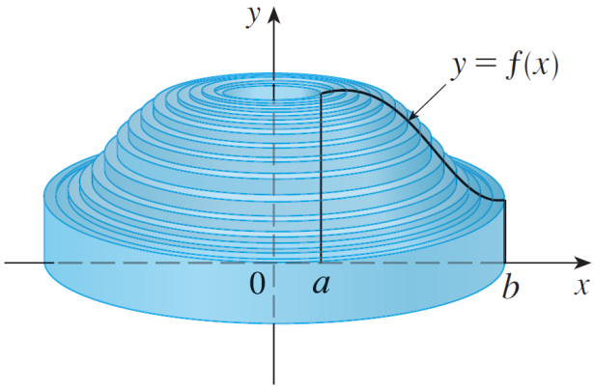
Volumes by Cylindrical Shells
If the rectangle with base [x_{i –1}, x_{i} ] and height is rotated about the y-axis, then the result is a cylindrical shell with average radius height and thickness (see
Figure 4), so by Formula 1 its volume is
Figure 4

Slide 10
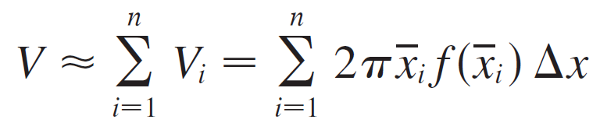

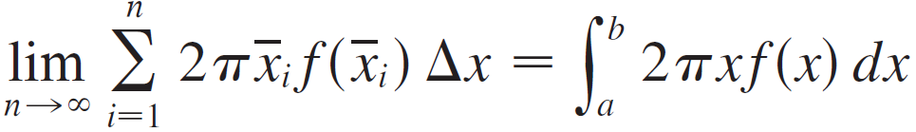
Volumes by Cylindrical Shells
Therefore an approximation to the volume V of S is given by the sum of the volumes of these shells:
This approximation appears to become better as
But, from the definition of an integral, we know that

Slide 11
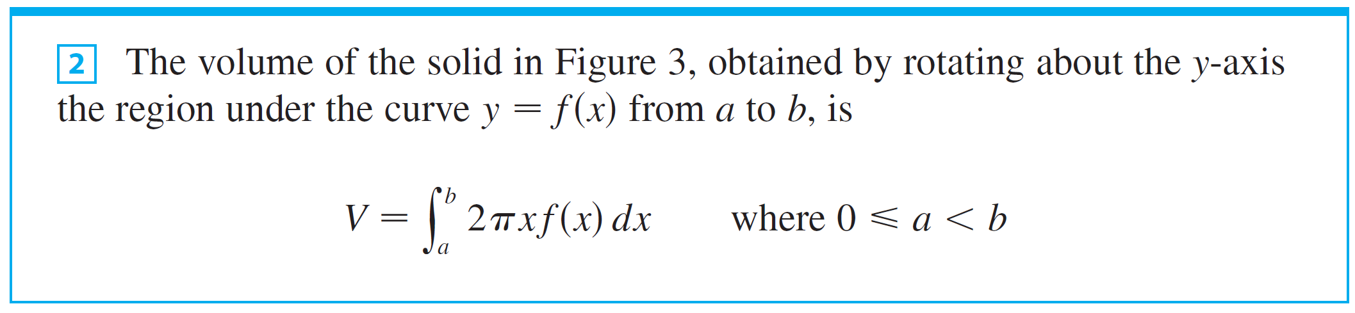
Volumes by Cylindrical Shells
Thus the following appears plausible:

Slide 12
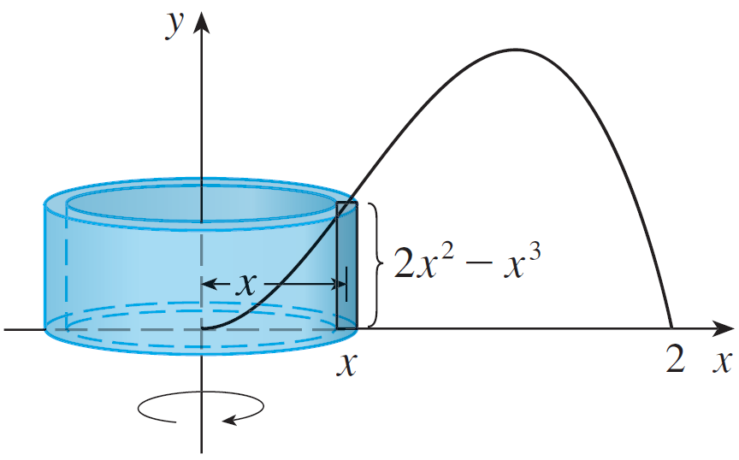
Example 1
Find the volume of the solid obtained by rotating about the y-axis the region bounded by y = 2x² – x³ and y = 0.
Solution:
From the sketch in Figure 6 we see that a typical shell has radius x, circumference 2πx, and height f (x) = 2x² – x³.
Figure 6

Slide 13
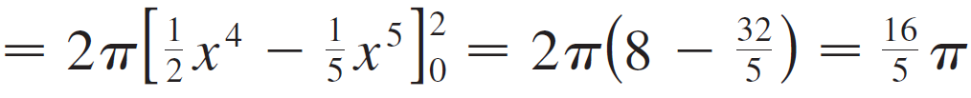
Example 1 – Solution
cont’d
So, by the shell method, the volume is

Slide 14
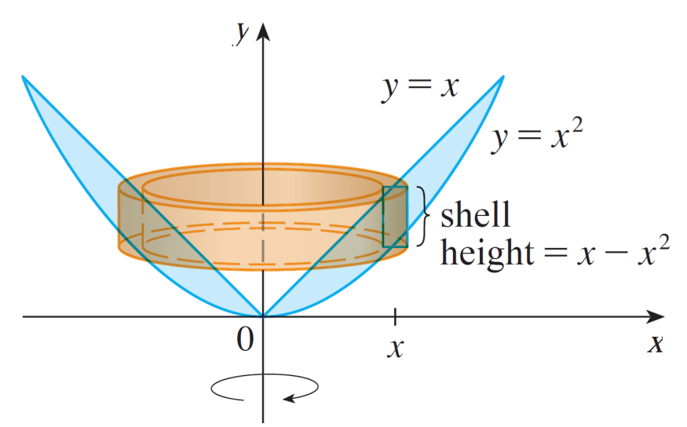
Example 2
Find the volume of the solid obtained by rotating about the y-axis the region between y = x and y = x².
Solution:
The region and a typical shell are shown in Figure 8. We see that the shell has radius x, circumference 2πx, and height f (x) = x² – x.
Figure 8

Slide 15
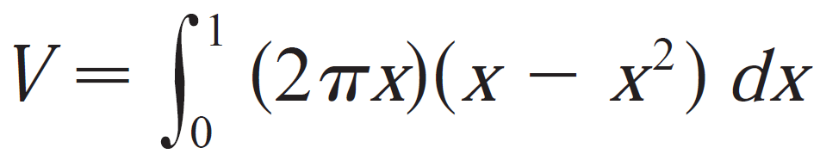
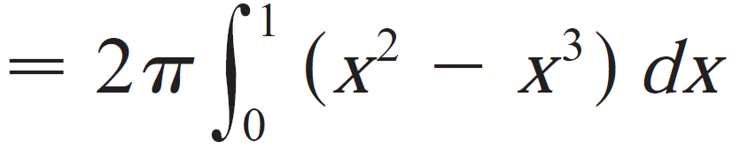
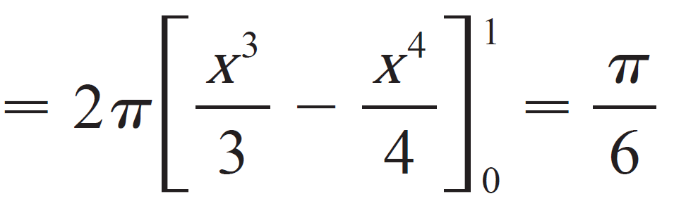
Example 2 – Solution
cont’d
So, by the shell method, the volume is

Slide 16
Volumes by Cylindrical Shells
As the next example shows, the shell method works just as well if we rotate about the x-axis.
We simply have to draw a diagram to identify the radius and height of a shell.

Slide 17

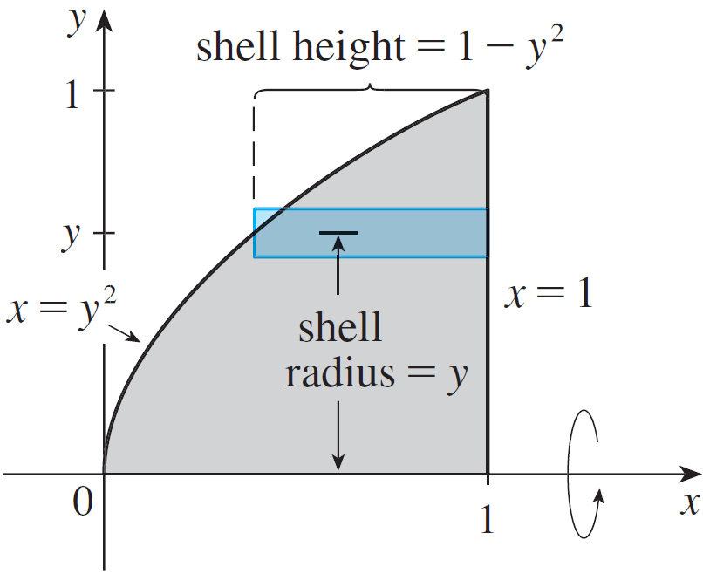
Example 3
Use cylindrical shells to find the volume of the solid obtained by rotating about the x-axis the region under the curve from 0 to 1.
Solution:
To use shells we label the
curve x = y² in Figure 9.
Figure 9

Slide 18
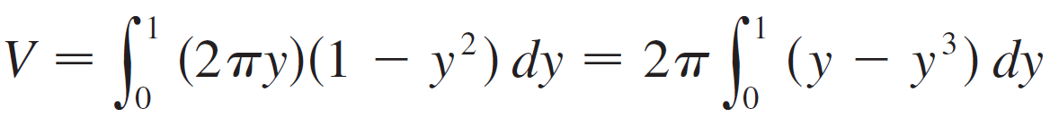
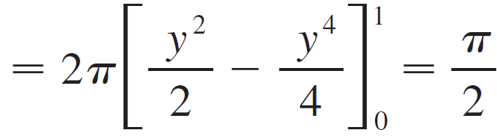
Example 3 – Solution
cont’d
For rotation about the x-axis we see that a typical shell has radius y, circumference 2π y, and height 1 – y².
So the volume is

Slide 19
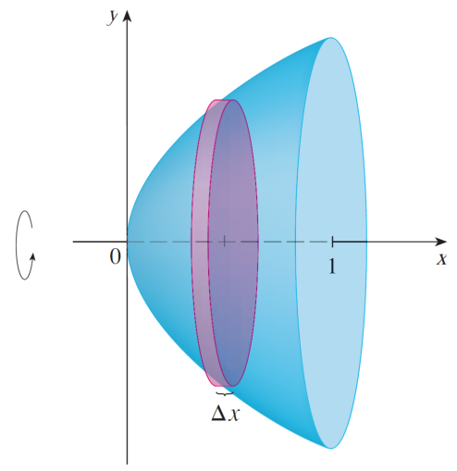
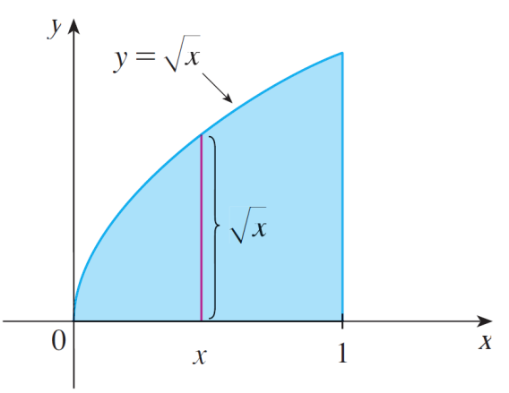


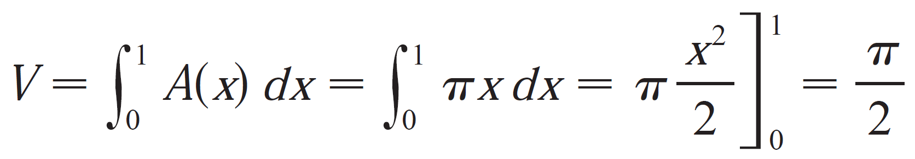
Example 3 – Solution
cont’d
In this problem, the volume by slicing is simpler.
When we slice through the point x, we get a disk with radius . The area of the cross-section is
The volume of solid between x=0 and x=1 is

